Slide 1
Age-specific changes in income in nine European countries
2008-2017
Bernhard Binder-Hammer, Sonja Spitzer, Alexia Fürnkranz-Prskawetz
13th Global Meeting on Population and the Generational Economy, August 2020
Our research is supported by JPI-MYBL and funded by the Austrian Federal Ministry of Education, Science and Research. JPI-MYBL is supported by J-Age II, which is funded by Horizon 2020, the EU framework programme for research and innovation, under grant agreement 643850.

Slide 2
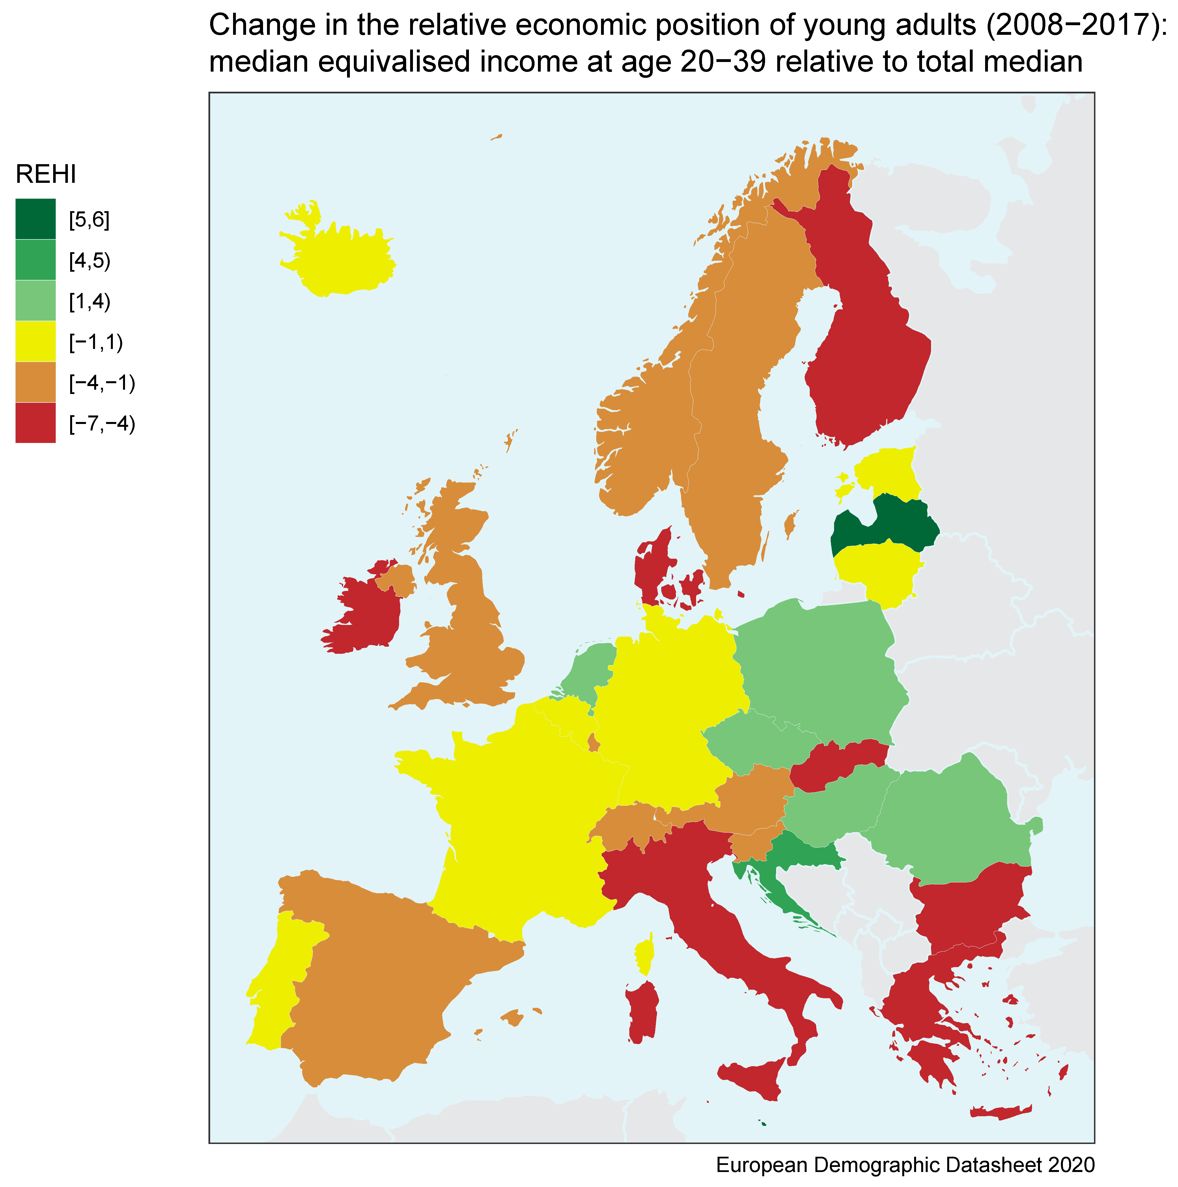
Motivation
Income young generations is declining/stagnating in Europe since 2008
Median equivalised income of population 20-39 relative to total median declined in 21 out of 29 countries
Source:
European Demographic Data Sheet http://www.populationeurope.org/en

Slide 3
Motivation

Slide 4
Objective:
Understanding the generational patterns of income changes 2008-2017
Research questions:
Change in aggregate incomes, taxes and benefits between 2008 and 2017?
Income changes of young adults compared to older working age adults and retirees?
Can the income changes be attributed to changes in employment, wages or social benefits?
Countries: Austria, Estonia, Greece, Spain, France, Italy, Poland, Sweden and Slovenia.

Slide 5
Aggregate income
We are interested in changes in:
Primary income of households (Y)
Taxes (less consumption taxes) in per cent of primary income
Social benefits in % of primary income
Disposable income

Slide 6
Aggregate income: changes 2008 – 2017 (households)
 | Real primary income |  |  | Disposable
Country | per capita (Y) | Income taxes | Social benefits | income
 | (%) | (% of Y) | (% of Y) | (%)
AT | -3 | 2 | 3 | -3
EE | 16 | 2 | 2 | 17
EL | -35 | 7 | 5 | -36
ES | -11 | 0 | 4 | -7
FR | -1 | 4 | 3 | -2
IT | -14 | 2 | 4 | -12
PL | 2 | 2 | 3 | 4
SE | 15 | 0 | 0 | 16
SI | -4 | 0 | 2 | -2
Decline of income in many countries
Increase of public redistribution

Slide 7
Age-specific income
Data source: EU-SILC
Net income in 3 age groups: 20-39, 40-59, 60+
Most important income components: income from employment, public transfers to individuals
All income components are individualised:
Family benefits assigned to caregiver
Asset income to adults
Imputed rent to person responsible for dwelling

Slide 8
Age-specific income: changes 2008-2017
Change in real net income 2008 - 2017 in %
Country | Total | Age 20-39 | Age 40-59 | Age 60+
AT | 3 | -1 | 2 | 11
EE | 17 | 17 | 28 | 7
EL | -34 | -43 | -39 | -24
ES | -4 | -18 | -9 | 8
FR | 3 | -4 | 0 | 8
IT | -5 | -17 | -9 | 4
PL | 2 | 5 | 3 | 1
SE | 12 | 4 | 16 | 14
SI | 4 | 1 | 5 | 7
Strong increase in income among the population 65+
Stagnation/decline in income for 20-39-year-old

Slide 9
Decomposition of income changes
Income changes by type of income
Income from employment
Income from public transfers
Other types of income
Decomposition of changes in income from emloyment
Change in employment
Change in income per employed person
Decomposition of changes in public transfers
Changes in number of non-employed persons
Changes in transfers per non-employed person

Slide 10
Decomposition of income changes, age group 20-39
 | Total |  |  |  |  |  | Inc.
 | net | Labour | Public | Other |  | Employ- | per
 | income | income | transfers | income |  | ment | empl.
Austria | -1 | -2 | 1 | 0 |  | -2 | 0
Estonia | 17 | 17 | 7 | -7 |  | -3 | 20
Greece | -43 | -35 | 0 | -7 |  | -11 | -24
Spain | -18 | -15 | -2 | 0 |  | -11 | -4
France | -4 | -2 | 1 | -2 |  | -5 | 2
Italy | -17 | -15 | 1 | -3 |  | -12 | -3
Poland | 4 | 0 | 5 | -1 |  | 2 | -1
Sweden | 4 | 3 | 2 | 0 |  | -3 | 6
Slovenia | 1 | -1 | 1 | 0 |  | -5 | 4
For 20-39-year-old changes in labour income most important
In Italy and Spain: reduction in income due to a decline in employment rates
In Greece decline in income and employment, in Estonia increase in labour income

Slide 11
Decomposition of income changes, age group 60+
 | Total |  |  |  |  |  | Income
 | net | Labour | Public | Other |  | Non- | per non-
 | income | income | transfers | income |  | empl. | empl.
Austria | 11 | 5 | 5 | 1 |  | -3 | 7
Estonia | 7 | 17 | 7 | -16 |  | -6 | 12
Greece | -24 | -4 | -14 | -6 |  | 0 | -15
Spain | 8 | 3 | 7 | -2 |  | -2 | 8
France | 8 | 6 | 8 | -5 |  | -3 | 11
Italy | 4 | 4 | 0 | 0 |  | -3 | 4
Poland | 1 | 5 | -4 | 0 |  | -4 | 0
Sweden | 14 | 3 | 8 | 3 |  | 0 | 9
Slovenia | 7 | 2 | 2 | 3 |  | -1 | 4
General: higher employment rates among the population 60+
Higher income due to higher employment and higher transfer benefits per non-employed

Slide 12
Summary: income changes 2008-2017
General:
Stagnating/declining aggregate inocme
Increase in public sector redistribution
Young population:
Stagnating/declining income among the young (age 20-39)
Reason: Stagnating incomes/declining employment rates
Increase in income of the young in Estonia and Poland
Large decline in income in Greece
Population 60+
Increase in income of the population 60+
Increase in employment rates and in public transfers

